Slide 1

Analysis On Health Survey Data
-Bhavarth Patel
-Sanskar Surana
-Jaggannath Pradhan
-Mansi Yedke

Slide 2

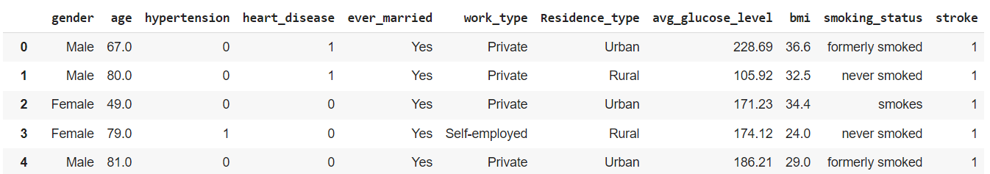
About project
To preform EDA , visualization and classification on a dataset
Dataset : Health status based on some categories
Data source : kaggle

Slide 3

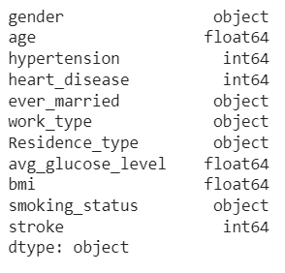
DATASET
Dataset : Health status based on some categories.
Shape : 4981 rows × 11 columns
Columns:
5 columns have object as datatype
3 columns have float as datatype
3 columns have integer as datatype
By using [df.info]

Slide 4
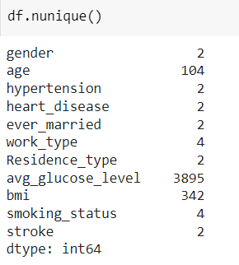
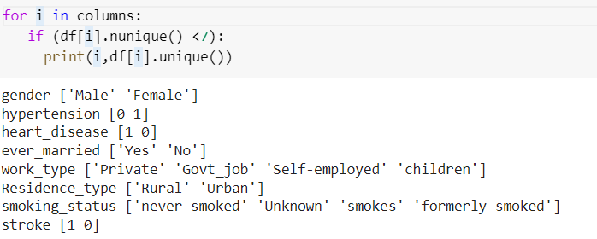
DATASET
It can be observed that 8 columns are categorical as the no. Of unique value very low .
Categorical column represent the data which may be divided into groups. Examples of categorical variables are race, sex, age group, and educational level.

Slide 5
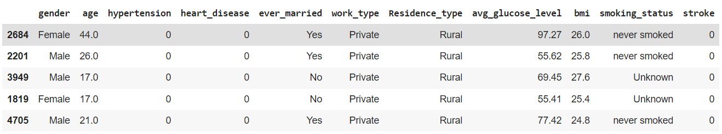
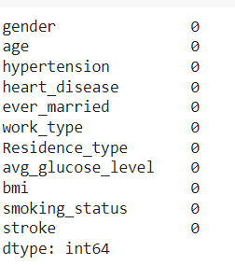
Understanding dataset
Random 5 rows of our dataset:
There is no null value as well.

Slide 6
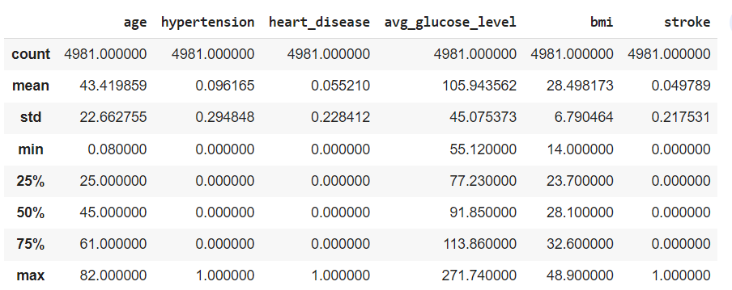
Understanding dataset
Description of dataset:
The above columns have numerical as datatype.

Slide 7

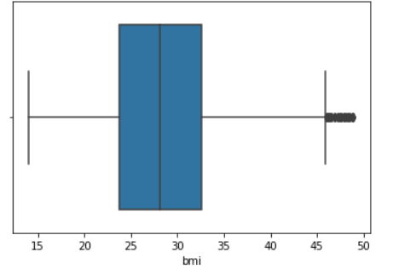
Dealing with outliers
An Outlier is a data-item/object that deviates significantly from the rest of the (so-called normal)objects.
They can be caused by measurement or execution errors.
Boxplot: It captures the summary of the data effectively and efficiently with only a simple box and whiskers.
Boxplot summarizes sample data using 25th, 50th, and 75th percentiles.
One can just get insights(quartiles, median, and outliers) into the dataset by just looking at its boxplot.
Original dataset had 4981 rows × 11 columns , but after removing the outliers we are left with only
4336 rows × 11 columns

Slide 8
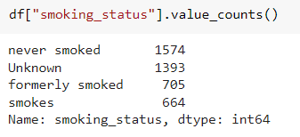
Dealing with “Unknown”
As observable , column smoking_status have a value as “Unknown”.
Value like unknown and null only make it hard to get observations
That’s why we will remove it, they are multiple ways to deal with it but
Here we choose it do it with replace() method
Before:
After

Slide 9
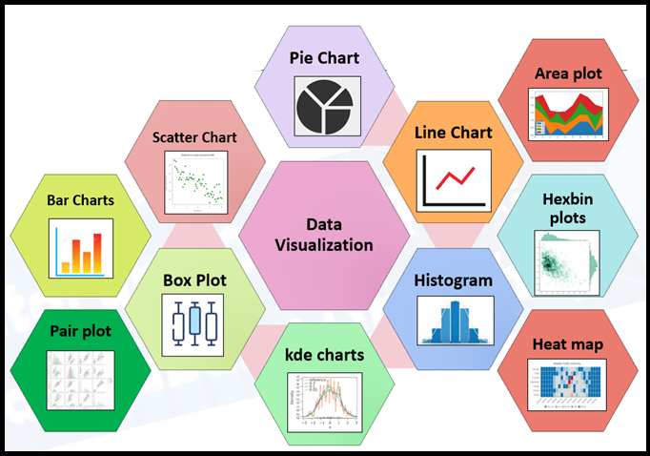
Data Visualization
Data Visualization is really important because :
Analyzing the Data in a Better Way
Data Visualization Discovers the Trends in Data
Data Visualization Provides a Perspective on the Data
Faster Decision Making
Making Sense of Complicated Data

Slide 10
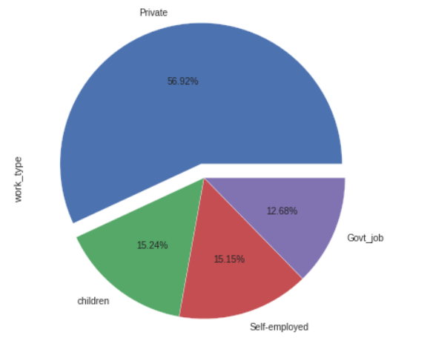
Data Visualization
The pie chart is about no. of people as per their work type
Form the pie chart it can be observed that most people have private job and least people have government job.

Slide 11
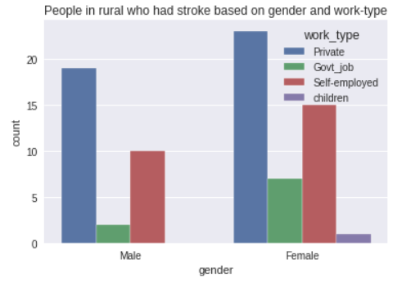
Data Visualization
Following bar graph is about no. of people who had stroke and their work type
It can be observed that women who work in private job have maximum count

Slide 12
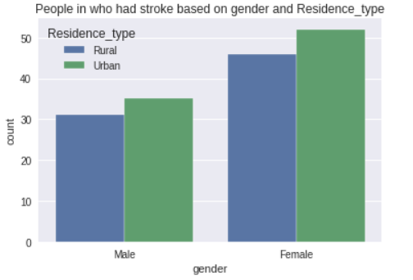
Data Visualization
Following bar graph is about no. of people who had stroke and residence type.
It can be observed that women higher count,
And also that urban women have higher rate in having stroke

Slide 13
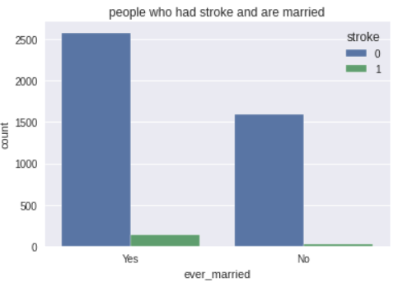
Data Visualization
In above , bar graph is about no. of people if they had stroke and if they are married or not.
People who had stroke is not properly visible.
So we will plot those in a different graph for better understanding

Slide 14
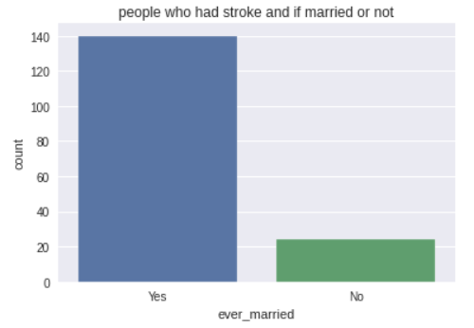
Data Visualization
In above , bar graph is about no. of people who had stroke and if they are married or not.
It can be observed that people who are married have higher count as per stroke.

Slide 15
Classification
Classification is a process of categorizing a given set of data into classes.
It can be performed on both structured or unstructured data.
The process starts with predicting the class of given data points.
The classes are often referred to as target, label or categories.
The classification predictive modeling is the task of approximating the mapping function from input variables to discrete output variables.
The main goal is to identify which class/category the new data will fall into.

Slide 16
Classification
Classifier – It is an algorithm that is used to map the input data to a specific category.
Classification Model – The model predicts or draws a conclusion to the input data given for training, it will predict the class or category for the data.
Binary Classification – It is a type of classification with two outcomes, for eg – either true or false.
Train the Classifier – Each classifier in sci-kit learn uses the fit(X, y) method to fit the model for training the train X and train label y.
Predict the Target – For an unlabeled observation X, the predict(X) method returns predicted label y.
Evaluate – This basically means the evaluation of the model i.e classification report, accuracy score, etc.

Slide 17
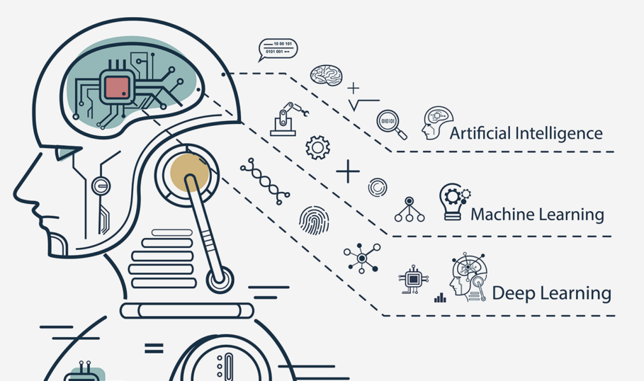
Machine Learning
Machine learning is a subset of AI, which enables the machine to automatically learn from data, improve performance from past experiences, and make predictions.
Machine learning contains a set of algorithms that work on a huge amount of data.
Data is fed to these algorithms to train them, and on the basis of training, they build the model & perform a specific task.

Slide 18
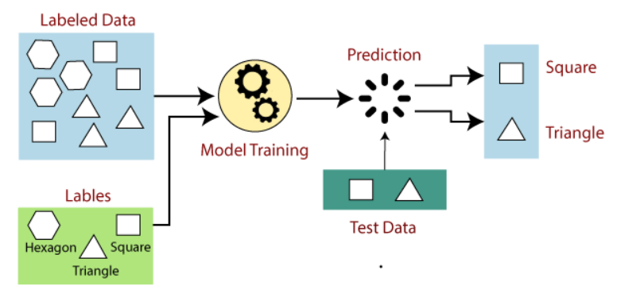
Supervised Machine Learning
Supervised learning is the types of machine learning in which machines are trained using well "labelled" training data, and on basis of that data, machines predict the output.
The labelled data means some input data is already tagged with the correct output.
In the real-world, supervised learning can be used for Risk Assessment, Image classification, Fraud Detection, spam filtering, etc.

Slide 19
Steps involved in Supervised Learning
First Determine the type of training dataset
Collect/Gather the labelled training data.
Split the training dataset into training dataset, test dataset, and validation dataset.
Determine the input features of the training dataset, which should have enough knowledge so that the model can accurately predict the output.
Determine the suitable algorithm for the model, such as support vector machine, decision tree, etc.
Execute the algorithm on the training dataset. Sometimes we need validation sets as the control parameters, which are the subset of training datasets.
Evaluate the accuracy of the model by providing the test set. If the model predicts the correct output, which means our model is accurate.

Slide 20
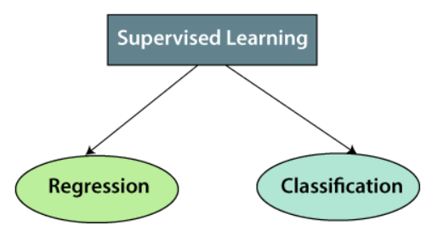
Types of supervised Machine learning Algorithms:
1. Regression
Regression algorithms are used if there is a relationship between the input variable and the output variable. It is used for the prediction of continuous variables, such as Weather forecasting, Market Trends, etc.
2. Classification
Classification algorithms are used when the output variable is categorical, which means there are two classes such as Yes-No, Male-Female, True-false, etc.
Random Forest
Decision Trees
Logistic Regression
Support vector Machines

Slide 21
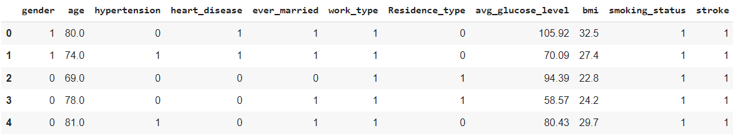
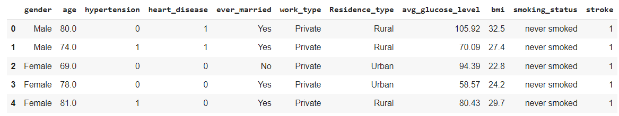
Encoding
Machine learning models require all input and output variables to be numeric.
This means that if your data contains categorical data, you must encode it to numbers before you can fit and evaluate a model.
Before encoding :
After encoding

Slide 22
Splitting of data
The scikit-learn library provides us with the model_selection module in which we have the splitter function train_test_split().
We split our Data into X_train,X_test,Y_train,Y_test
Training data consists 80% & testing data consists 20% from original dataset
Logistic regression :
Logistic regression is an example of supervised learning.
Logistic regression aims to solve classification problems.
It does this by predicting categorical outcomes, unlike linear regression that predicts a continuous outcome.
With our dataset we can apply it for stroke and heart disease

Slide 23
Splitting of data
The scikit-learn library provides us with the model_selection module in which we have the splitter function train_test_split().
We split our Data into X_train,X_test,Y_train,Y_test
Training data consists 80% & testing data consists 20% from original dataset
Logistic regression :
Logistic regression is an example of supervised learning.
Logistic regression aims to solve classification problems.
It does this by predicting categorical outcomes, unlike linear regression that predicts a continuous outcome.
With our dataset we can apply it for stroke and heart disease

Slide 24
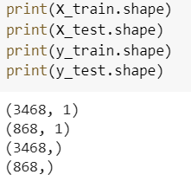


Splitting of data
At first attempt we tried to split data with age and possibility of having heart disease.
Training data consists 80% & testing data consists 20% from original dataset
After applying logistic regression
We got 95% accuracy

Slide 25
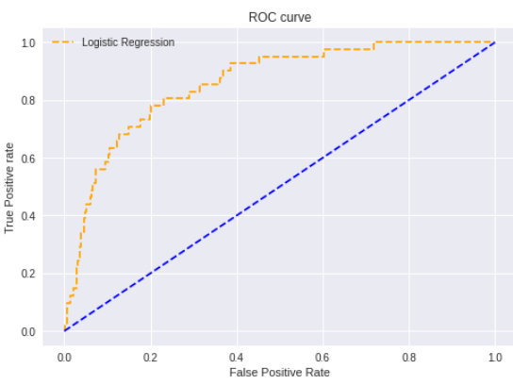
ROC curve of data
An ROC curve (receiver operating characteristic curve) is a graph showing the performance of a classification model at all classification thresholds. This curve plots two parameters:
True Positive Rate
False Positive Rate
From ROC curve , we can observe that the
performance of our model is good as the
AUC is higher , it can distinguish between the classes

Slide 26
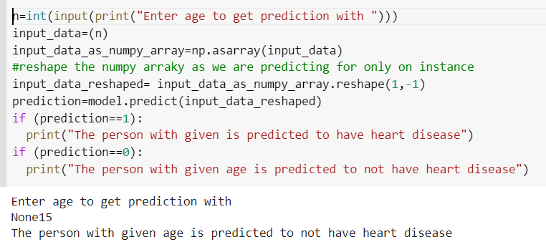
Making Prediction
So we used our model to predict if a person with age(input) will have heart disease or not.
Here, we the prediction will be 1 or 0
1 – person have heart disease
0 – person don’t have heart disease
Here, we tried to predict with age 15
And the person is predicted to not have heart disease

Slide 27
Findings
People who work in private job are more likely to be a smoker.
Count of people who are married and having a heart disease is more that those who are not married.
Count of People in private job having heart disease is more than any other work-type.
Count of males who smokes is more than females who smokes.
Children are not likely to have a stroke, its very rare.

Slide 28
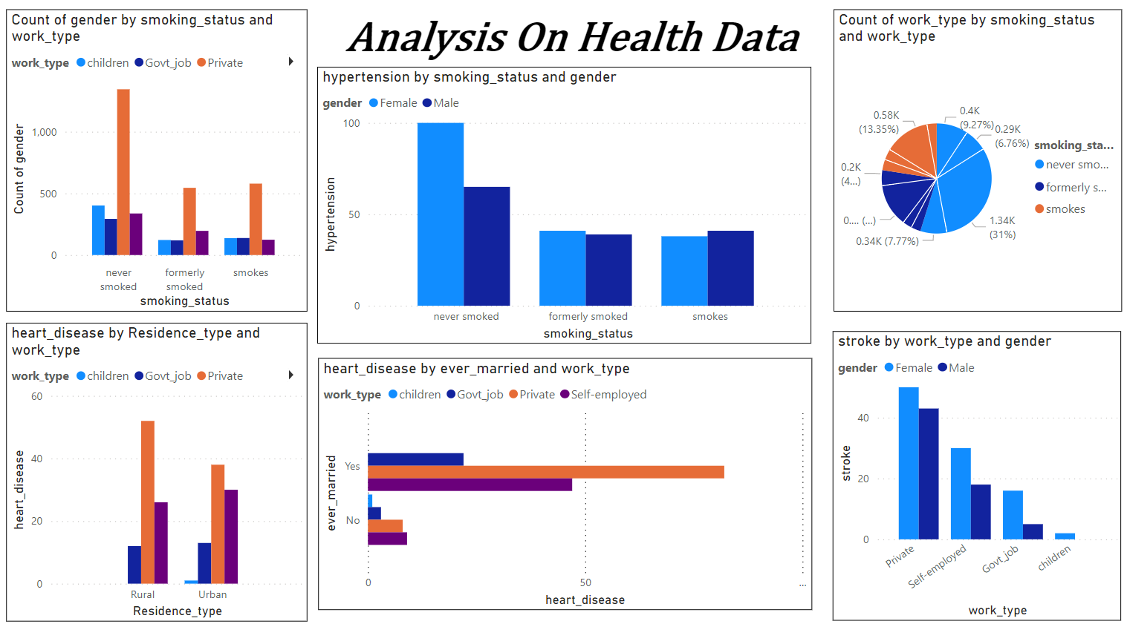
Dashboard
Here is the dashboard on the entire dataset.

